Slide 1
Control Unit <number>
Overview
  Control Memory
  Comparison of Implementations
  Sequencing Microinstructions
  Design of Control Unit
  Address Sequencer

Slide 2
Control Unit <number>
Control Unit
Control unit (CU) of a processor translates from machine instructions to the control signals for the microoperations that implement them
Control units are implemented in one of two ways
Hardwired Control
  CU is made up of sequential and combinational circuits to generate the control signals
  - expensive, complex, no flexibility
  - high-speed (optimized to provide fast mode of operations)
  -ex Intel 8085, Motorola 6802, Zilog 80, RISC CPUs
Microprogrammed Control
  A control memory on the processor contains microprograms that activate the necessary control signals
  - Ex Intel 8080, Motorola 68000, CISC

Slide 3
Control Unit <number>
Control Unit Implementations
Combinational Logic Circuits (Hard-wired)
Control Data
Memory
I R
Status F/Fs
Control Unit's State
Timing State
Combinational
Control
Logic Circuits
Points
CPU
Ins. Cycle State
Microprogram
M
Control Data
e
m
Status F/Fs
o
I R
r
y
C
Control
C
C
Next Address
S
Storage
S
D
P
CPU
Generation
A
(μ-program
D
s
Logic
R
memory)
R
}

Slide 4
Control Unit <number>
Terminology
Microprogram
- Program stored in memory that generates all the control signals required
to execute the instruction set correctly
- Consists of microinstructions
Microinstruction
- Contains a control word and a sequencing word
Control Word - All the control information required for one clock cycle
Sequencing Word - Information needed to decide
the next microinstruction address
- Vocabulary to write a microprogram
Control Memory(Control Storage: CS)
- Storage in the microprogrammed control unit to store the microprogram
Writeable Control Memory(Writeable Control Storage: WCS)
- CS whose contents can be modified
-> Allows the microprogram can be changed
-> Instruction set can be changed or modified
Dynamic Microprogramming
- Computer system whose control unit is implemented with
a microprogram in WCS
- Microprogram can be changed by a systems programmer or a user

Slide 5
Control Unit <number>
Terminology
Sequencer (Microprogram Sequencer)
The next address generator is sometimes known as microprogram sequencer
A Microprogram Control Unit that determines the Microinstruction Address to be executed in the next clock cycle
- increment the control address register by 1
- loading into control AR an address from control memory
- Transferring and external address
- loading an initial address to start control operation
Control Data Register:
- sometimes known as pipeline register .
- allows execution of microoperations specified by control word
simultaneously with generation of next microinstruction

Slide 6
Control Unit <number>
Terminology
Advantage of Microprogram Control
- Once hardware configuration is established no need to further h/w or wiring
change
- only thing to change is microprogram residing in control memory.
RISC Architecture concept:
- Reduced Instruction Set Computer (RISC) system used hardwire control
rather than microprogram control

Slide 7
Control Unit <number>
Address Sequencing
Microinstructions are stored in control memory in groups with each specifying a routine.
Each instruction has its own microprogram routine in control memory to generate microoperation that generate instructions.
Initial address is loaded into CAR when power is turned on.
- the address of the first microinstruction that activates instruction
fetch (End instn in IR)
Control memory next must go through routine that determines the effective address of the operand (End : operand in MAR)
Next step is to generate the microoperations that execute the instruction fetched from memory.
The transformation from the instruction code bits to an address in control memory where routine is located is referred to as mapping

Slide 8
Control Unit <number>
Micro Instruction Sequencing
Instruction code
Mapping
logic
Status
bits
Branch
MUX
Multiplexers
logic
select
Subroutine
register
(SBR)
Control address register
(CAR)
Incrementer
Control memory (ROM)
select a status
bit
Branch address
Microoperations
Sequencing Capabilities Required in a Control Storage
- Incrementing of the control address register
- Unconditional and conditional branches
- A mapping process from the bits of the machine instruction to an address for control memory
- A facility for subroutine call and return

Slide 9
Control Unit <number>
Micro Instruction Format
Machine instruction format
15
14
11
10
0
I
Opcode
Address
Sample machine instructions
Symbol OP-code Description
  ADD 0000 AC ← AC + M[EA]
  BRANCH 0001 if (AC < 0) then (PC ← EA)
  STORE 0010 M[EA] ← AC
  EXCHANGE 0011 AC ← M[EA], M[EA] ← AC
Microinstruction Format
3
3
3
2
2
7
F1
F2
F3
CD
BR
AD
F1, F2, F3: Microoperation fields
CD: Condition for branching
BR: Branch field
AD: Address field

Slide 10
Control Unit <number>
Micro Instruction Format
F1 | symbol
000 | NOP
001 | ADD
010 | CLRAC
011 | INCAC
100 | DRTAC
101 | DRTAR
110 | PCTAR
111 | WRITE
F2 | symbol
000 | NOP
001 | SUB
010 | OR
011 | AND
100 | READ
101 | ACTDR
110 | INCDR
111 | PCTDR
F3 | symbol
000 | NOP
001 | XOR
010 | COM
011 | SHL
100 | SHR
101 | INCPC
110 | ARTPC
111 | Reserved

Slide 11
Control Unit <number>
Micro Instruction Format
CD | symbol | Condition
00 | U | Always 1
01 | I | DR (15)
10 | S | AC (15)
11 | Z | AC = 0
BR | symbol | Function
00 | JMP | CAR ← AD if Condition=1 else CAR ← CAR + 1 if condition = 0
01 | CALL | CAR ← AD, SBR ← CAR +1 if condition =1 else CAR ← CAR + 1 if condition = 0
10 | RET | CAR ← SBR
11 | MAP | CAR(2-5) ← DR (11-14), CAR(0,1,6) ←0

Slide 12
Control Unit <number>
Design of Control Unit
microoperation fields
F1
F2
F3
3 x 8 decoder
3 x 8 decoder
3 x 8 decoder
7
6
5
4
3
2
1
0
7
6
5
4
3
2
1
0
7
6
5
4
3
2
1
0
AND
ADD
Arithmetic
AC
DR
DRTAC
logic and
shift unit
From
From
PCTAR
DRTAR
PC
DR(0-10)
Load
AC
Select
0
1
Multiplexers
Load
AR
Clock

Slide 13
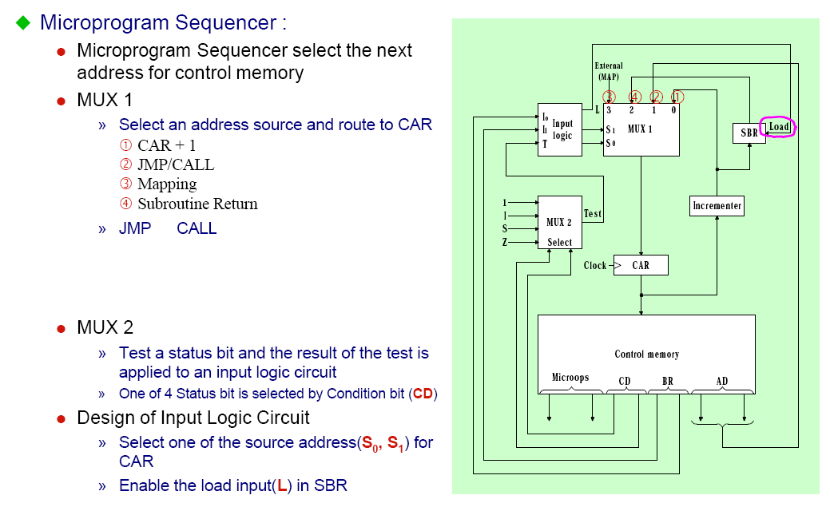
Control Unit <number>
Address Sequencer

Slide 14
Control Unit <number>
Address Sequencer
External
RETURN form Subroutine
(MAP)
In-Line
S₁S₀ Address Source
00 CAR + 1, In-Line
01 SBR RETURN
10 CS(AD), Branch or CALL
11 MAP
3
2
1
0
L
S
SBR
Subroutine
CALL
1
MUX1
S
0
Address
source
selection
Incrementer
Clock
CAR
Control Storage
MUX-1 selects an address from one of four sources and routes it into a CAR
- In-Line Sequencing → CAR + 1
- Branch, Subroutine Call → CS(AD)
- Return from Subroutine → Output of SBR
- New Machine instruction → MAP

Slide 15



